Slide 1
Dhiya Kowtha
Portfolio Website - Midterm Project

Slide 2
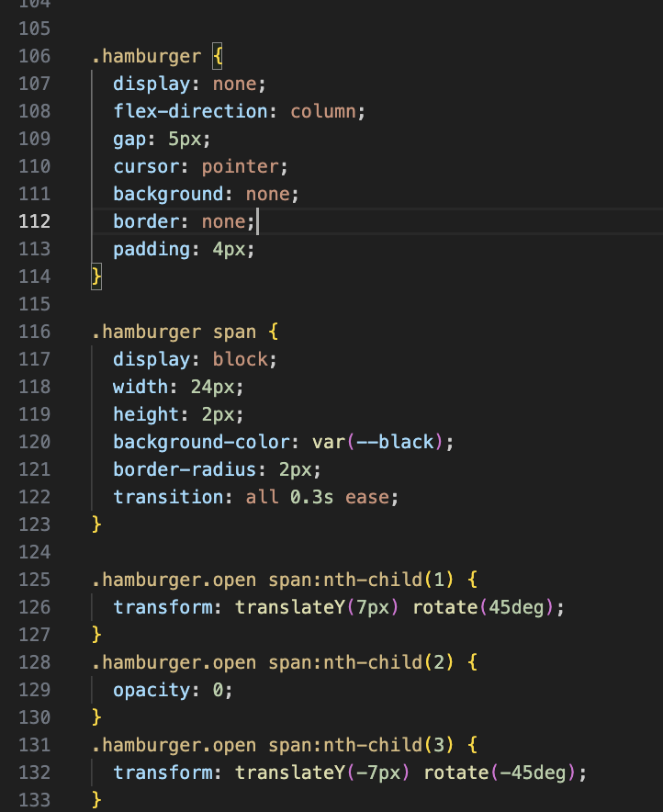
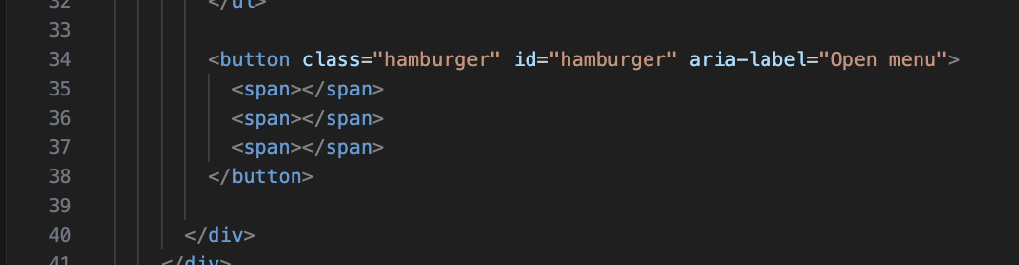
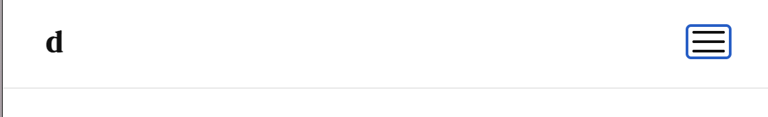
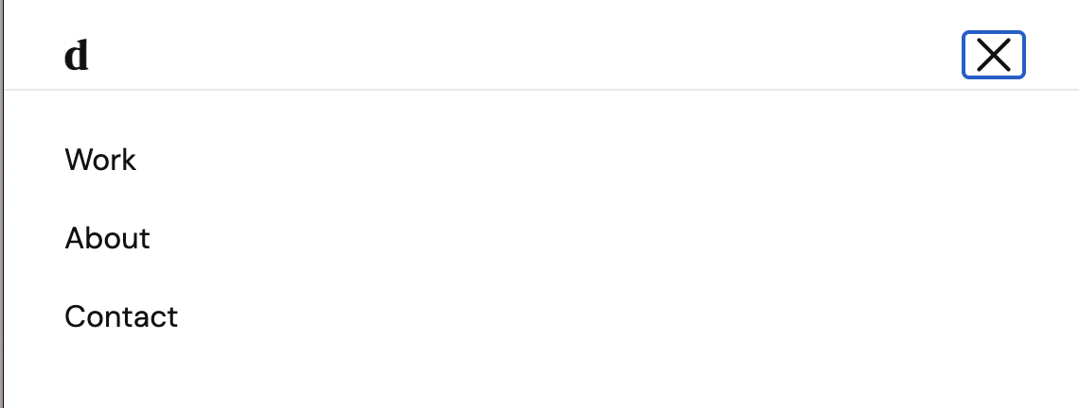
Each of these becomes one line of the icon. I used CSS to make it look like 3 horizontal bars
The .open class triggers the CSS to rotate the lines into an X I kept forgetting to add the transition which is why the animation wasn't smooth at first

Slide 3
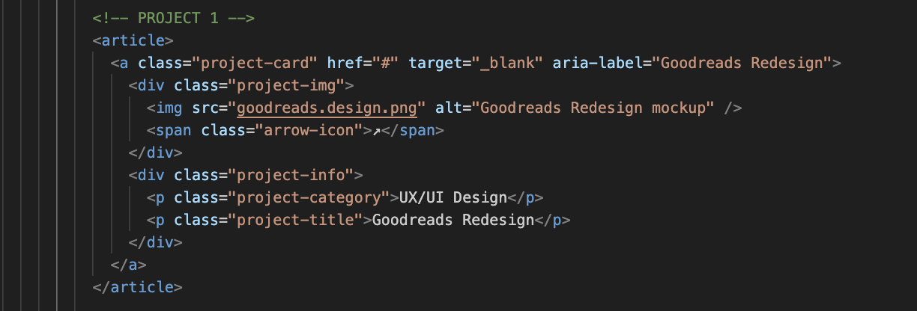
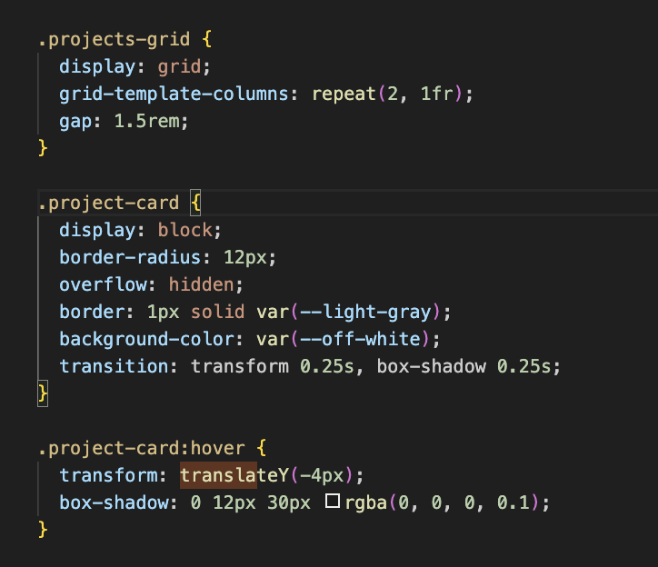
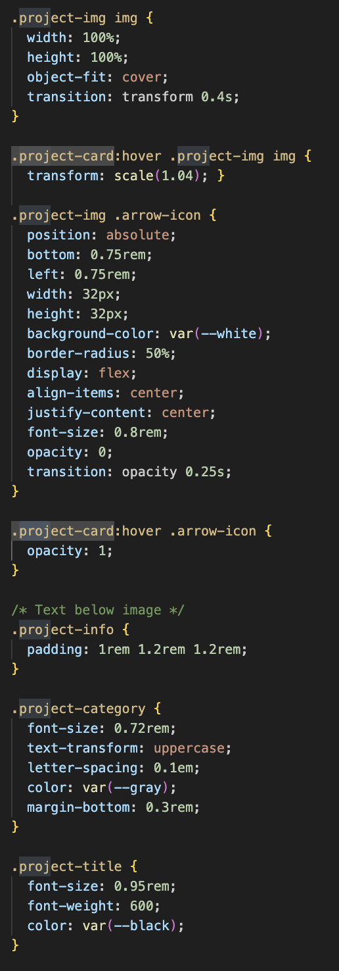
I used an <article> tag to wrap each card, inside it I have an <a> tag that makes the whole card one big clickable link. Then I have the image and below that the project category and title. The hover effects are what I'm glad I was able to figure out. When you hover over a card it lifts up slightly using transform: translateY and gets a shadow underneath it. The image also zooms in a tiny bit using scale.

Slide 4
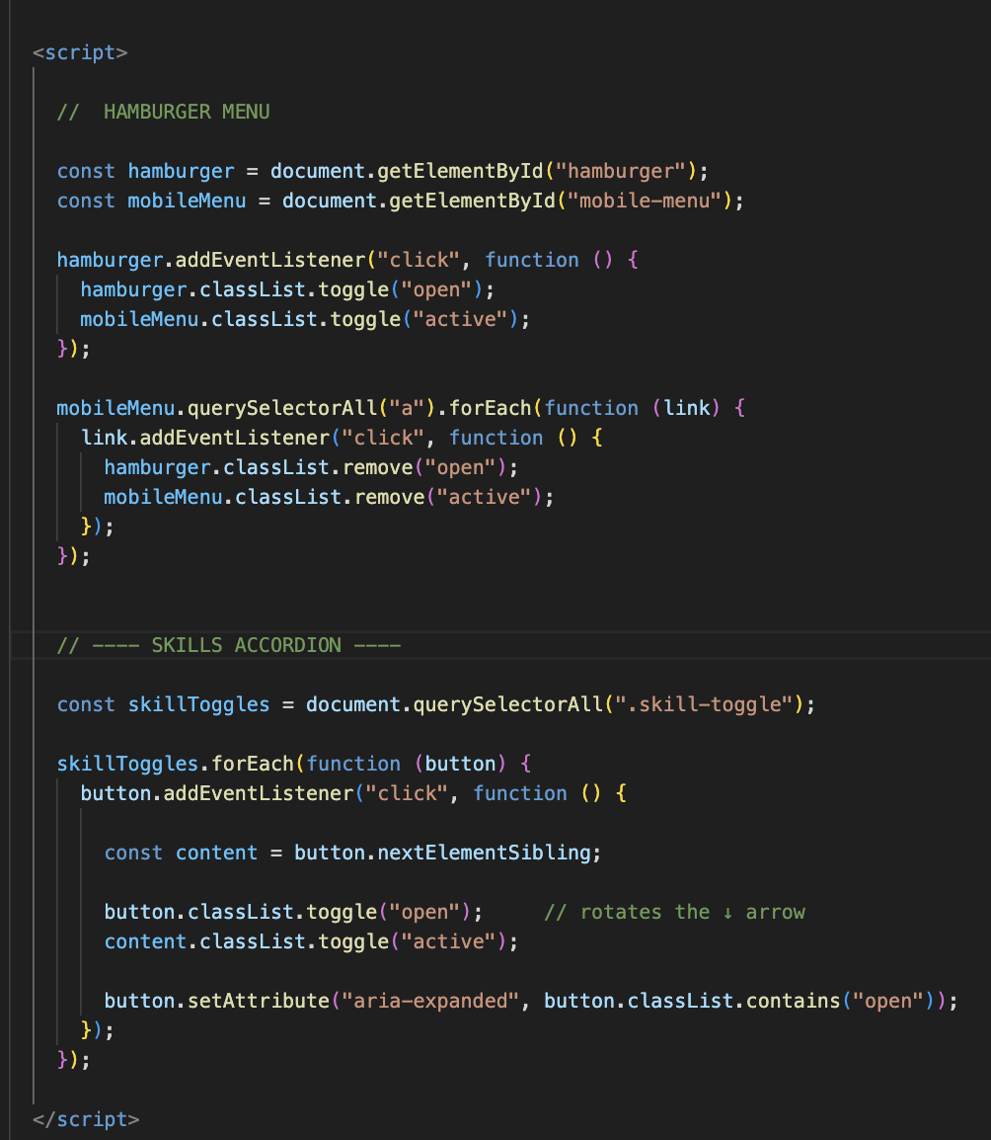
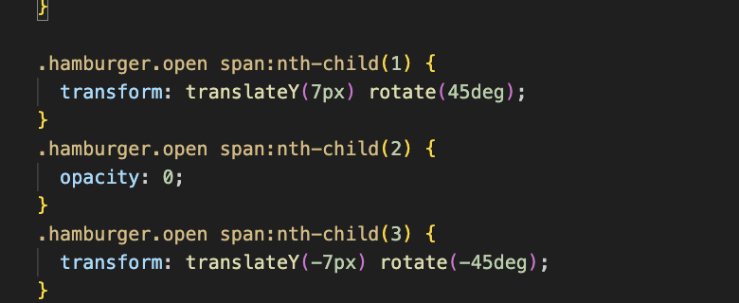
I used JavaScript for the hamburger menu and the skills dropdown.
JavaScript finds the element, waits for a click, and then adds or removes a CSS class. Once the class is added, the CSS does all the work, like showing the menu or rotating the arrow.

Slide 5
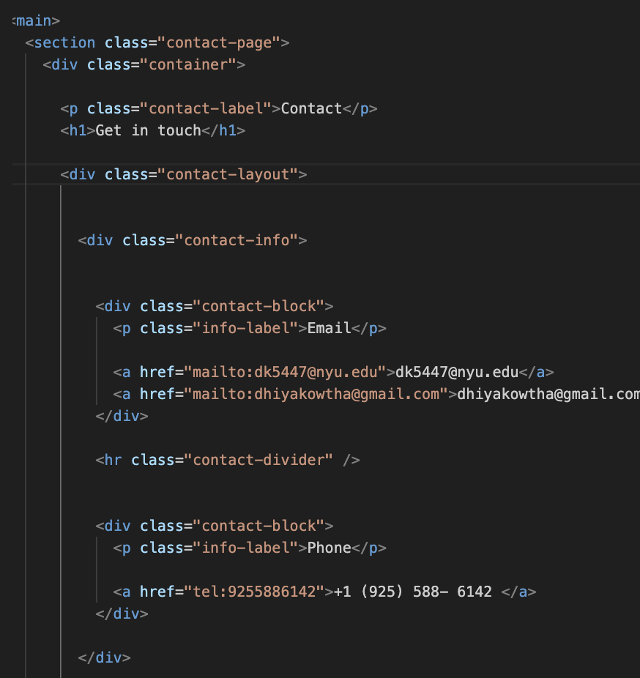
The mailto link tells the browser to open a mail app when clicked. The tel: input type also does this for a phone number.

Slide 6
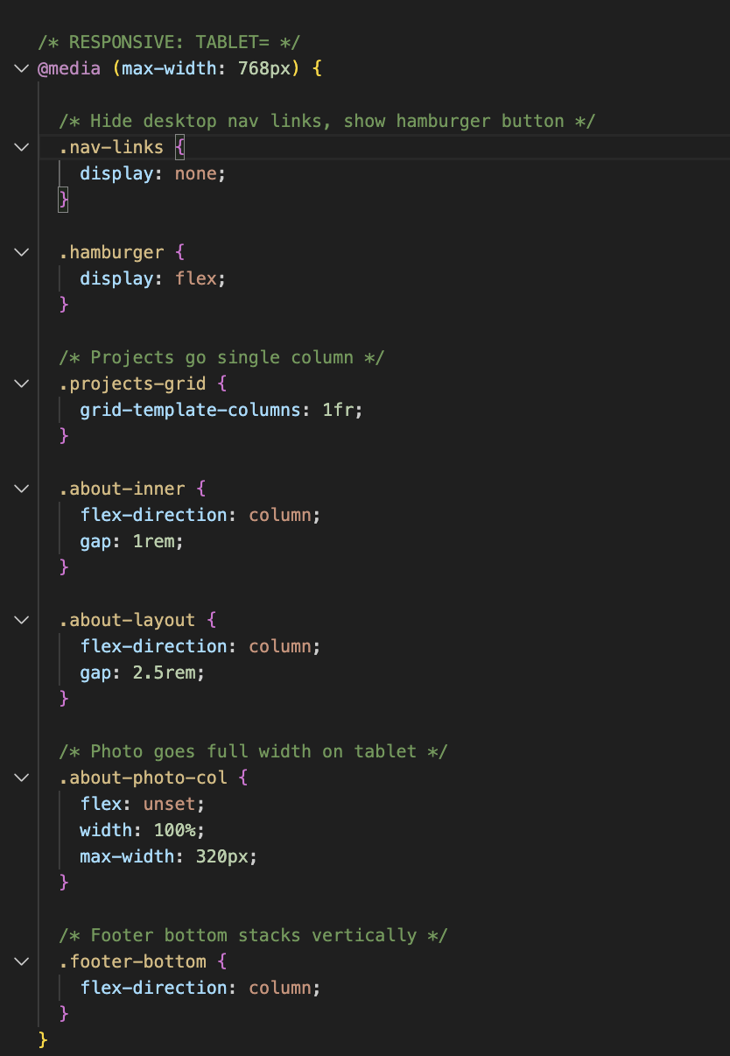
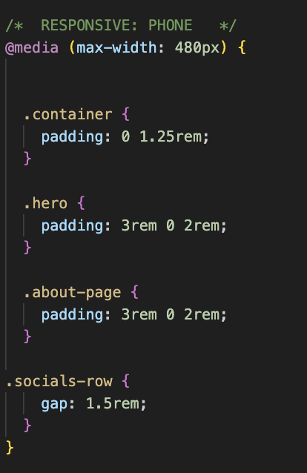
Media queries

Slide 7
Next Steps!
Create working pages for each project, create case studies
Do a contact page instead of linking the emails and numbers
Make it more accessible

Slide 8
Thank you!!

